Slide 1


PRASAHNNA NAKARMI 22085551
Mini Weather Station
Exploring Real-Time Weather Monitoring
Image source: canva

Slide 2
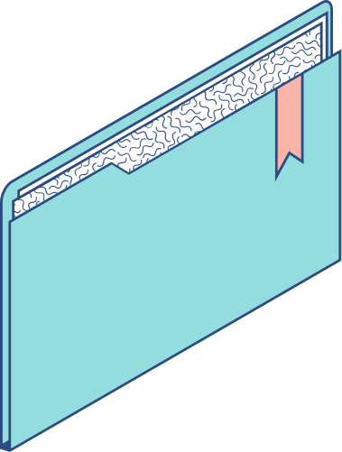
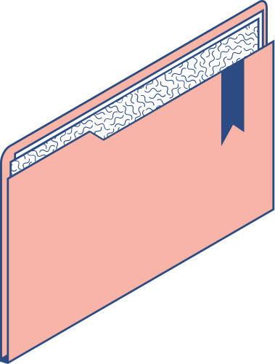
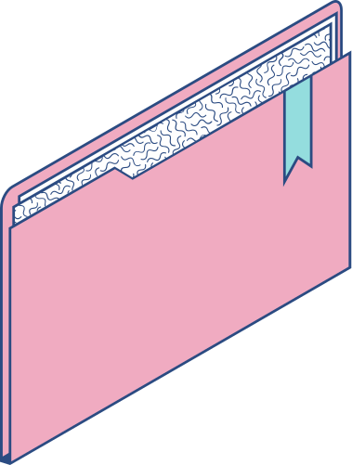
Contents
KEY TOPICS DISCUSSED IN THIS PRESENTATION
Introduction Data Acquisition Data Transmission Data Processing and Management Data Analysis and Visualization
Image source: canva

Slide 3

Introduction
IoT enhanches communication and information retrival
A device which measures the condition of atmosphere
Image source: canva

Slide 4

Introduction
Key components: DHT11, Arduino, I2C module
Real time temperature & humidity display
Image source: canva

Slide 5
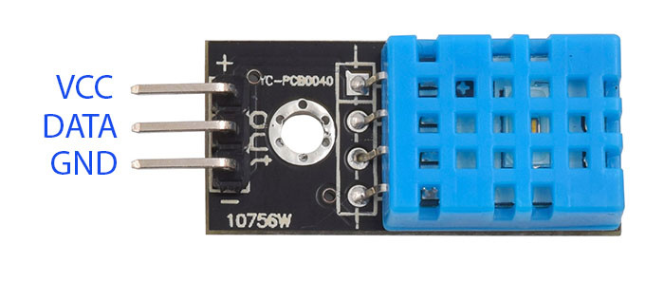
Data Acquisition
DHT11 is used for temperature and humidity mesurement Measures temperature between 0 to 50°C. Humidity measuring ranges from 20% to 80%
Image source: The Machine Shop

Slide 6
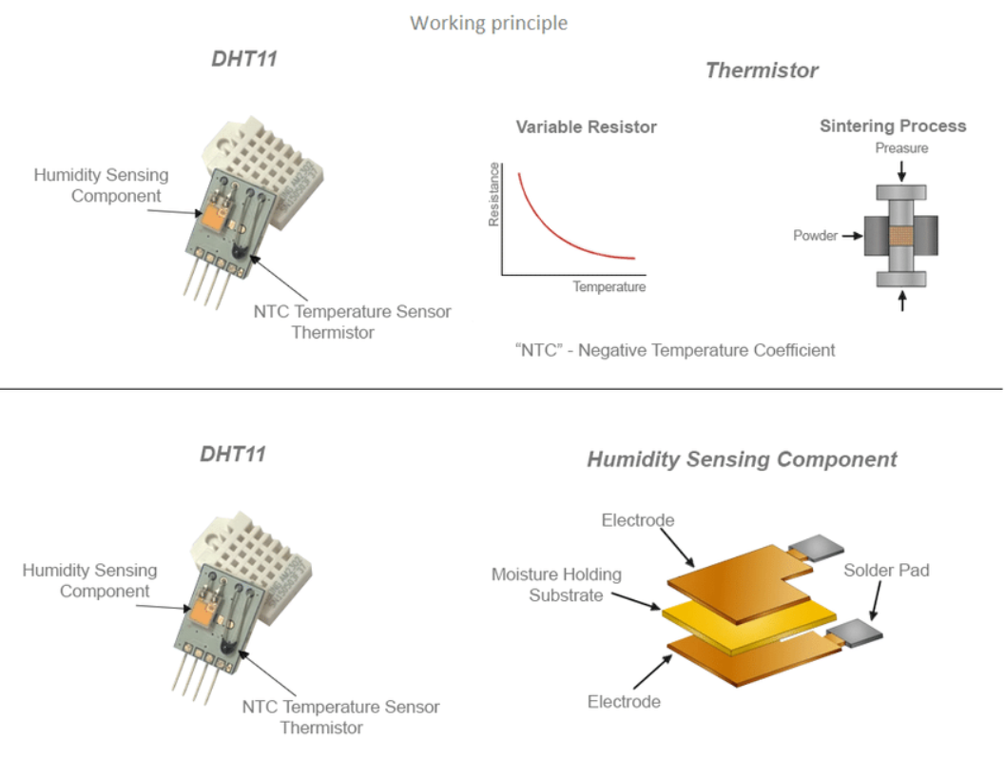
Data Acquisition
Figure: DHT11 temperature mesurement
Image source: ResearchGate

Slide 7
Data Acquisition
Figure: DHT11 humidity mesurement
Image source: ResearchGate

Slide 8
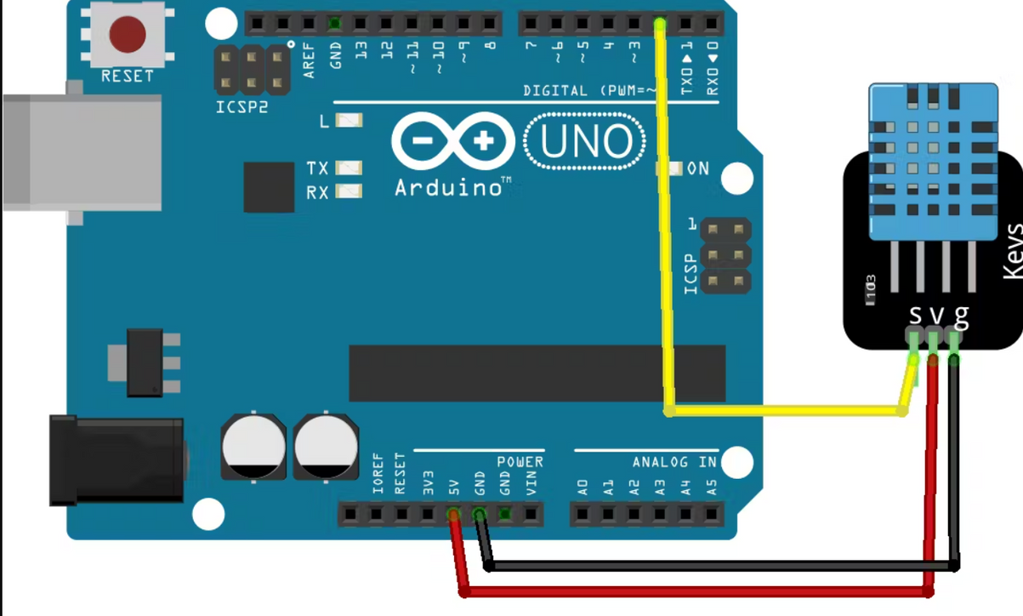
Data Transmission
Figure: DHT11 connection with Arduino
Image source: Hackster.io

Slide 9
Data Transmission
DHT11 uses one-wire communication protocol
Clock signal is not used; internal synchronization with Arduino's signal

Slide 10
IC senses analog signal and converts the value to digital form
NTC transmits digital data to Arduino through singal signal wire
Data Transmission

Slide 11
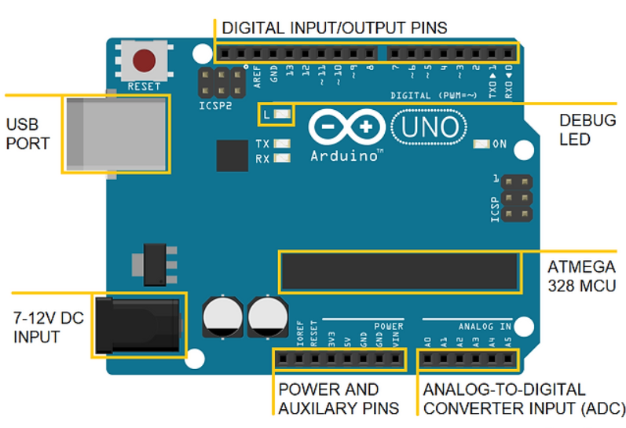
Data Processing and Management
Figure: Arduino Uno layout
Image source: Imaad Shaik

Slide 12
Data Processing and Management
Arduino is an integrated circuit with microcontrollers for instruction storage and execution.
Arduino IDE

Slide 13
Data Processing and Management
NTC thermistor’s resistance decrease with increase of temperature.
IC processes changes in resistance from the moisture holding layer to digital form.

Slide 14
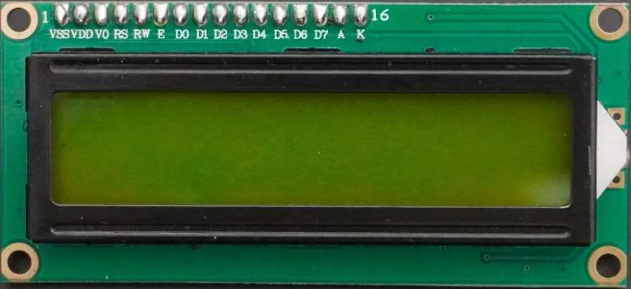
Data analysis and visualization
Smooth communication with LCD through I2C protocol.
Arduino communicates with LCD through LiquidCrystal_I2C library.
Image source: ElectronicWings

Slide 15
Data analysis and visualization
Basic user controls
LCD displays real-time data with adjustable delay.

Slide 16
Potential for advanced features like charts.
Advanced sensors for user interaction for analyzing and visualizing the data
Data analysis and visualization

Slide 17
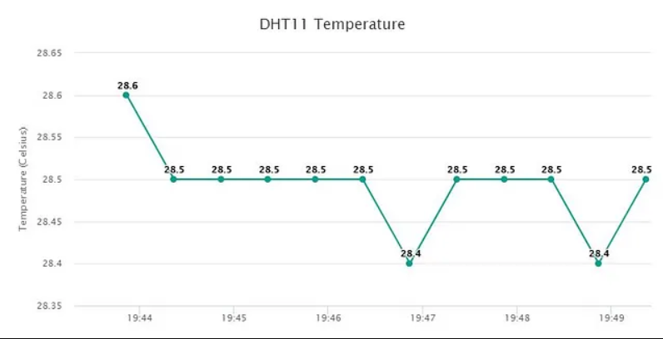
Temperature graph
Image source: Medium

Slide 18
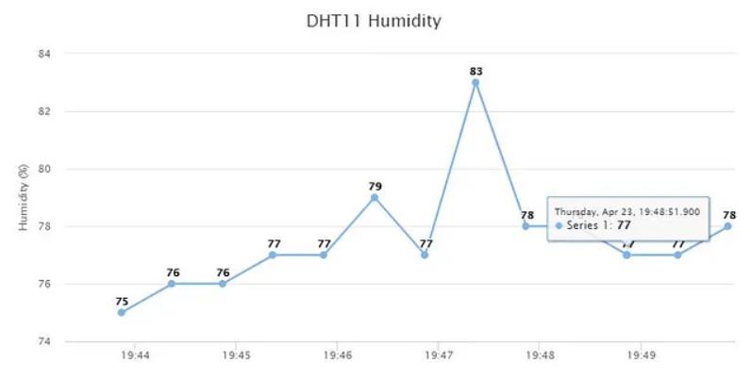
Humidity graph
Image source: Medium

Slide 19
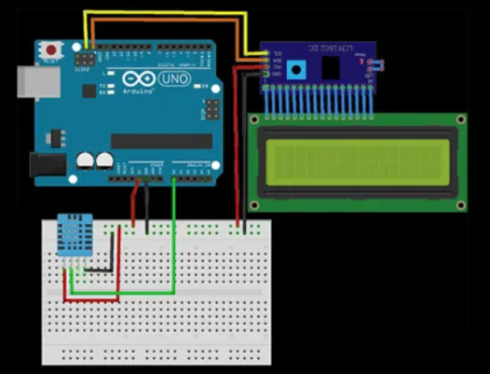
Circuit Diagram
Image source: electronics simplified

Slide 20
Thank you!

